Slide 1


HTML media

Slide 2

Topics Covered
Introduction to HTML Media
Image
Audio
Video
iFrame
Issues with iframe
SVG (Scalable Vector Graphics)

Slide 3

Introduction to HTML Media

Slide 4
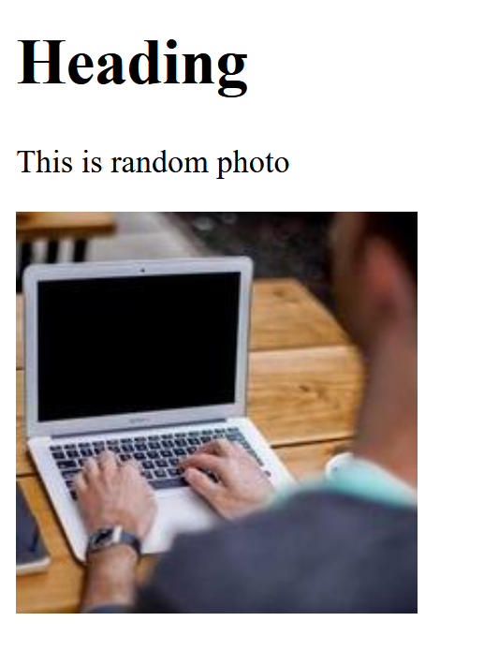
Image tag <img/>
<img src="image.jpg" alt="img tag syntax"/>

Slide 5
Picture tag <picture>
<picture>
<source srcset="image1.jpg" media="(min-width: 700px)"/>
<source srcset="image2.jpg" media="(min-width: 450px)"/>
<source src="image3.jpg" alt="photos"/>
</picture>

Slide 6
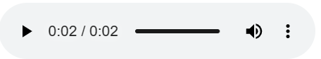
Audio tag <audio/>
<audio src="audio.mp3" controls/>

Slide 7
Audio with multiple sources
<audio controls>
<source src="audio.opus" type="audio/ogg; codecs=opus" />
<source src="audio.ogg" type="audio/ogg; codecs=vorbis" />
<source src="audio.mp3" type="audio/mpeg" />
</audio>

Slide 8
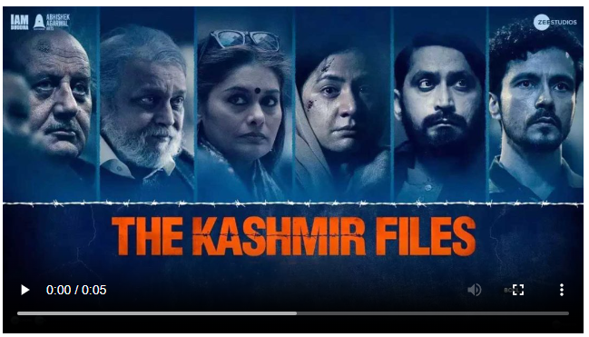
Video tag <video/>
<video src="video.mp4" controls"></video>

Slide 9
Video with multiple sources
<video width="620" controls>
<source src="video.ogv" type="video/ogg" />
<source src="video.avi" type="video/avi" />
<source src="video.mp4" type="video/mp4" />
Sorry, your browser doesn't support embedded videos.
</video>

Slide 10
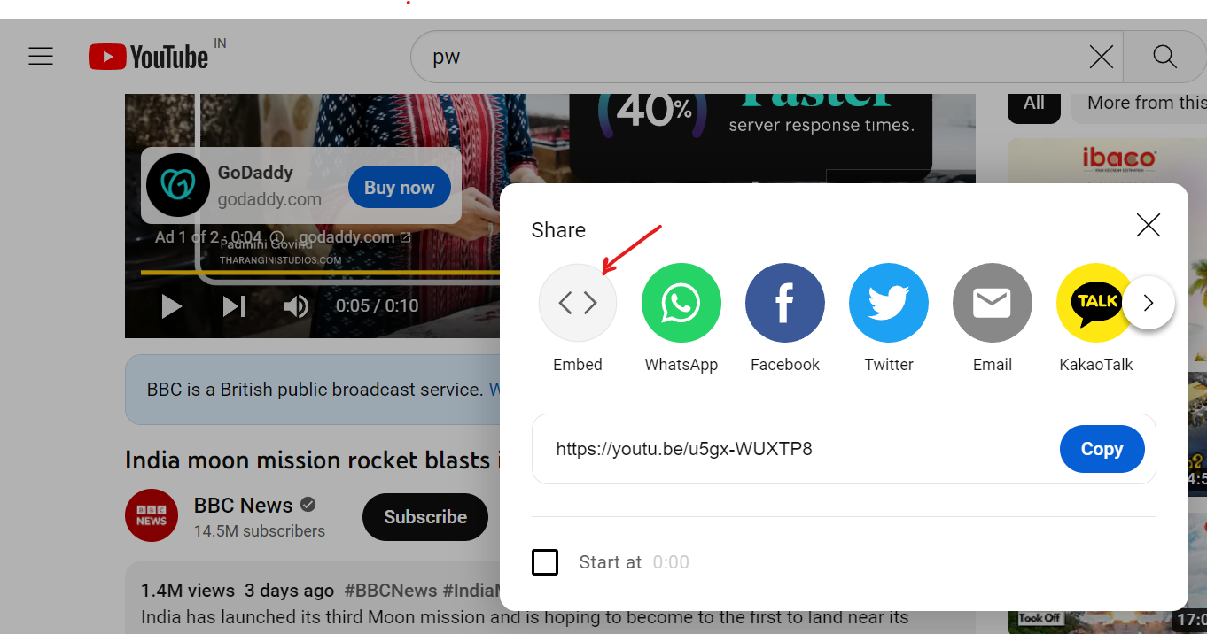
iFrame tag <iframe/>
<iframe src="document_url"></iframe>

Slide 11

Issues with iframe

Slide 12

SVG (Scalable Vector Graphics)
<svg version="1.1" width="300" height="300" xmlns="http://www.w3.org/2000/svg">
<!-- Here shapes SVG elements will come -->
</svg>

Slide 13
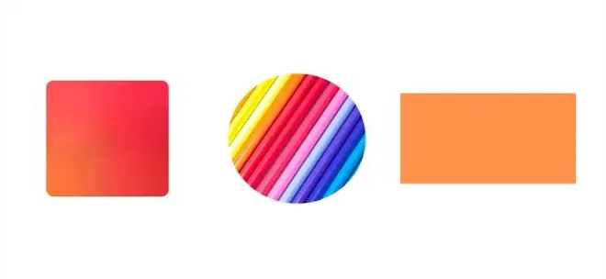
Canvas
<canvas width="120" height="120">
<!-- render shapes, lines etc. here -->
</canvas>

Slide 14
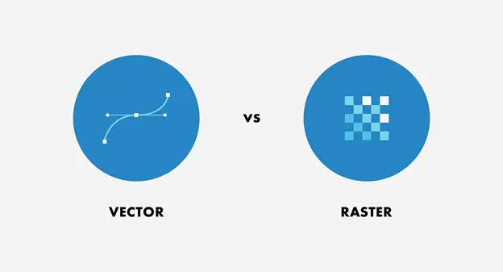
SVG vs Canvas

Slide 15

THANK YOU

